Slide 1
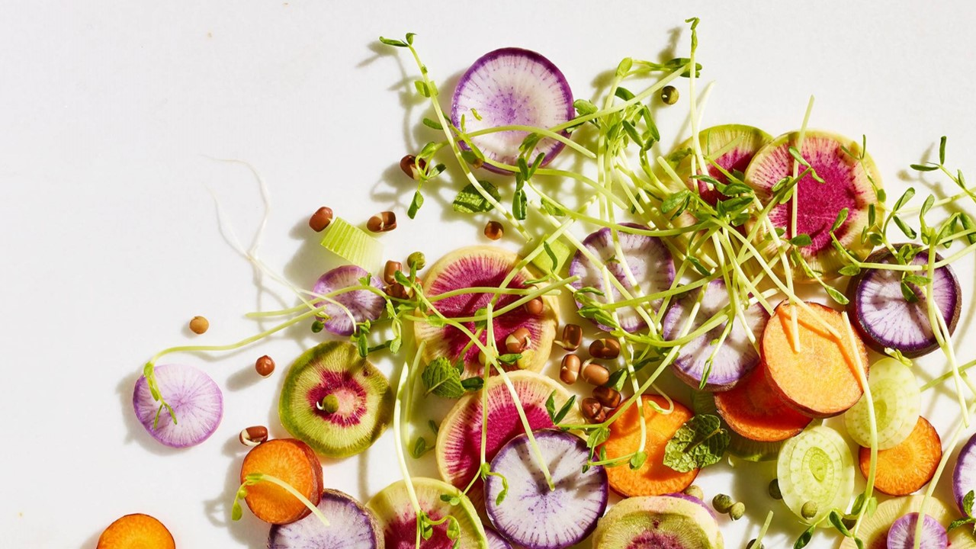
Tasty Bytes
By Aymen Mehrez

Slide 2
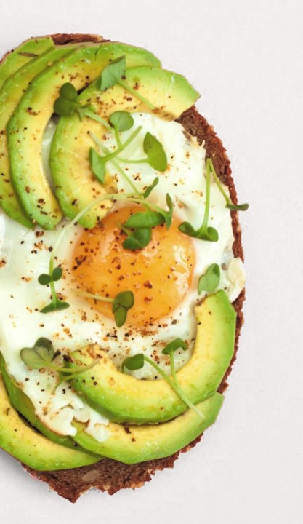
Project Overview
business goals
Introduction
Data validation
Exploratory analysis
Model development
Metrics for business to monitor
Summary

Slide 3
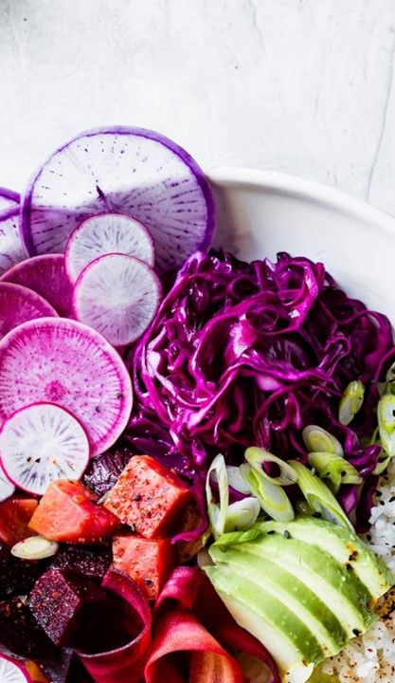
business goals
Maximize Traffic
Enhance Customer Satisfaction
Enhancing awareness of healthy meals

Slide 4
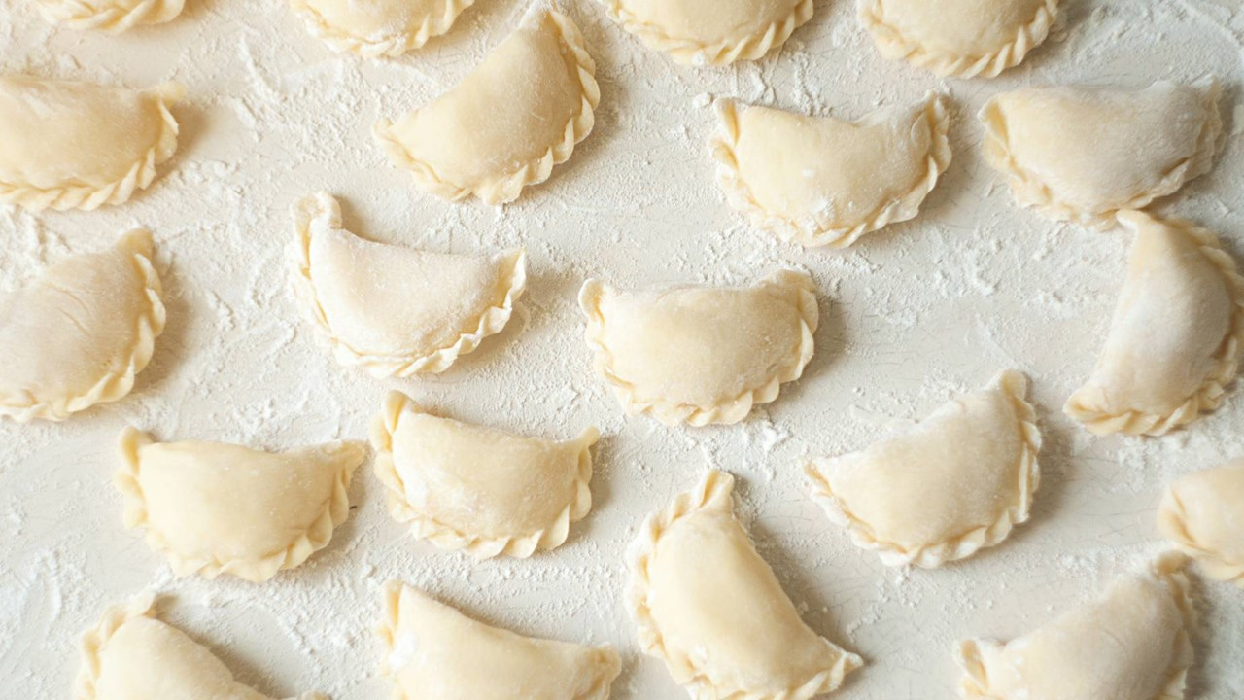
Introduction
During the project:
- Analyze current data
- which recipes that lead to high traffic?
- Model that predicts high traffic recipes

Slide 5
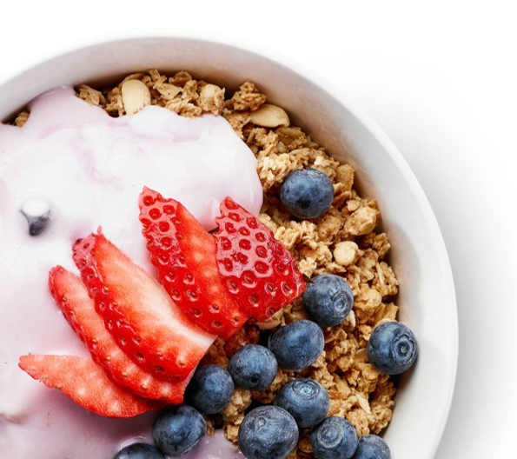
Data validation
Data cleaning
1
Nans are located in the macronutrient variables
2
Represent only 5.5% of the records
3
Other Nan represent the target variable ( recipe not generating high traffic)
4
“Servings” variable has anomalies
MAP the target variable “high_traffic” into bool data type

Slide 6
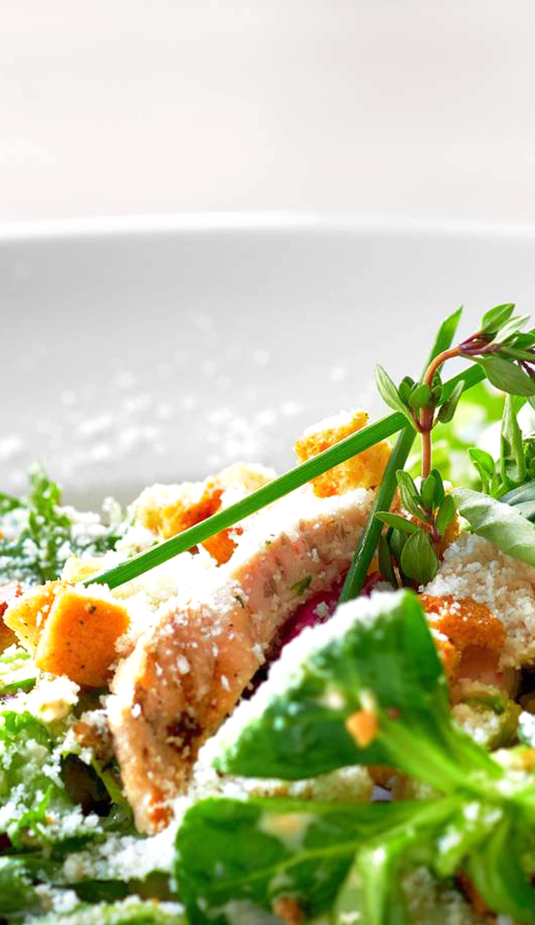
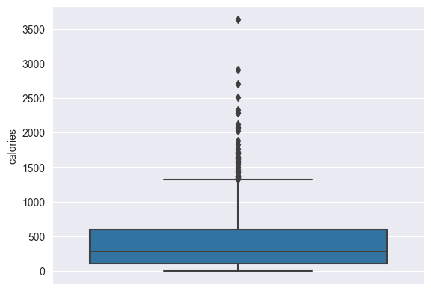
Exploratory analysis
Calories
Exploring the distribution of the calories variable
Some recipes have calories >2000
We keep the One Dish Meal Category
Heighten the threshold to 2400

Slide 7

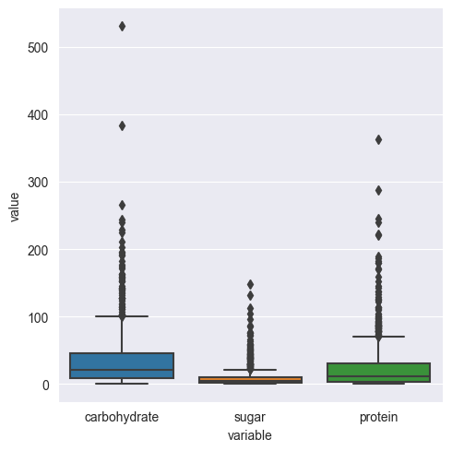
Exploratory analysis
macronutrients
Exploring the distribution of the carbohydrates, sugar and protein variables
Protein >280 isn’t realistic
Same thing for carbs > 300
Most likely typo issue

Slide 8
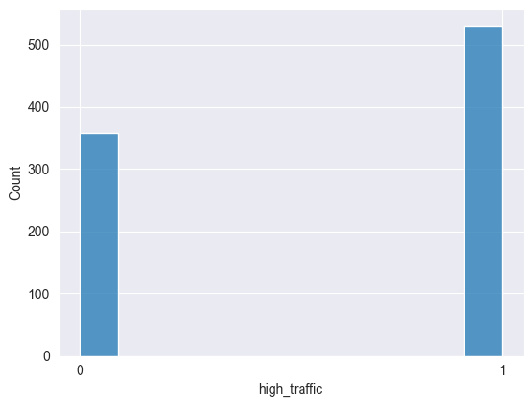
Exploratory analysis
High_traffic
Checking for the balance of the data so we don’t end up with biased model
approximately 60% of records indicated high traffic, while the remaining 40% denoted low traffic.

Slide 9
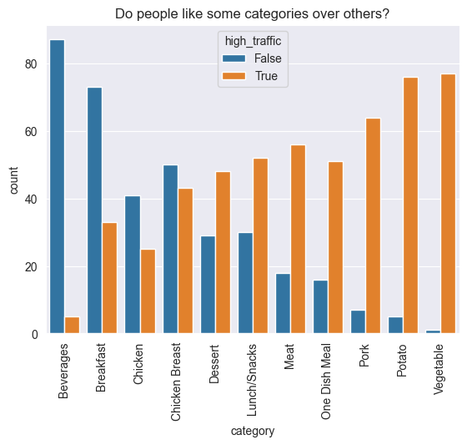
NOTICE
Traffic is not identically distributed across recipe categories
Healthy food is generating more traffic
Pork is the most in-demant type of meat for our customers

Slide 10
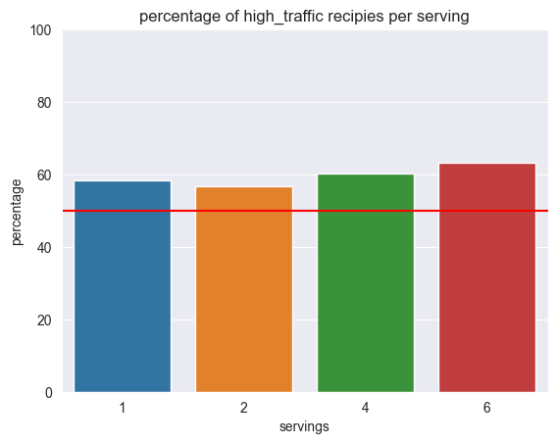
NOTICE
Assessment on whether it’s the same case for servings
Customers are indifferent about the number of servings per recipe
Nearly 58% of all types of servings are generating high_traffic

Slide 11
Model development
1
Logistic Regression:
.performed well but was too sensitive to the training data sampling
2
Linear SVC:
Performed worse that the other 2
3
Random Forest Classifier:
Even though it had a bad accuracy, it had the best tradeoff between precision and recall thus best f1_score
Voting Classifier
the 3 previous models were combined into a soft voting classifier
It had good accuracy , best f1 score
It’s less sensitive to train , test sampling

Slide 12
Metrics for business to monitor
The Traffic-Category Distribution
Traffic per 100 recipes

Slide 13
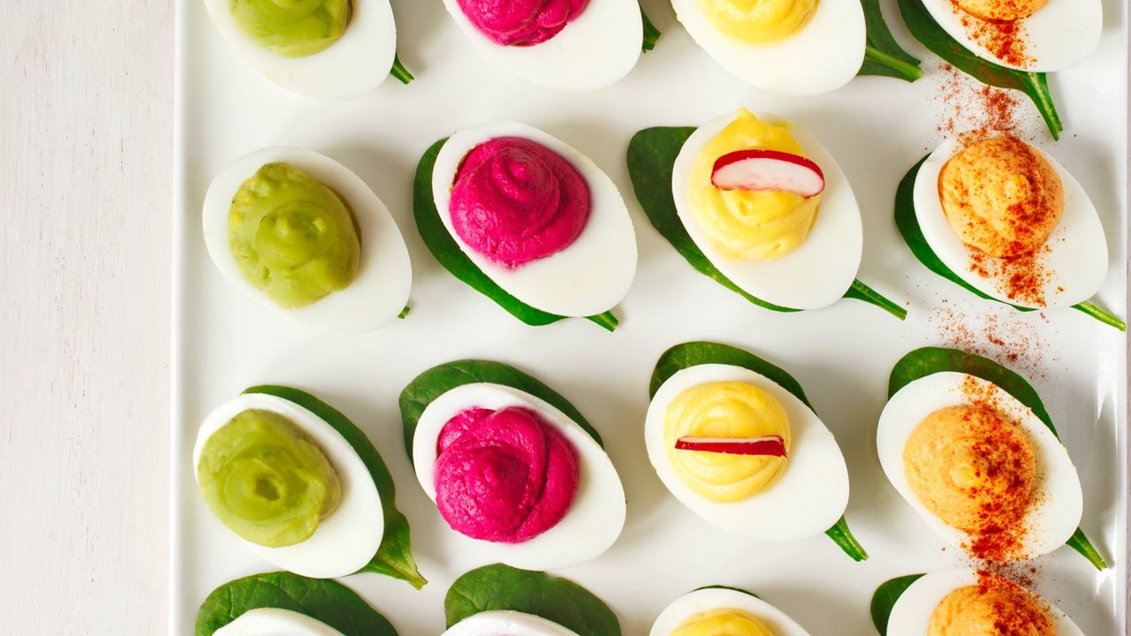
SUMMARY
Dropping the Beverage Recipe Category2 tablespoons olive oil
Reducing Emphasis on Servings per Recipe
Enhanced Focus on Select Categories
Optimizing Macronutrient Calculation

